Slide 1
myCorpus
Exploring a collection of JP>EN translations by a single translator
Mark Streer ・METIS (DS/ML) ・ 2021-11-12
Notes:
Hi everyone, today I’ll be discussing how I applied NLP and unsupervised learning to a personal project of mine.
I understand everyone in the audience is pretty familiar with topic modeling, so you might appreciate some of the technical details.

Slide 2

Client
Technical translator
Japanese>English
~500 research articles from 2013-2021
How can NLP improve my translation workflow?
How can I apply NLP tools best to add value to language services for Japanese professionals?
Notes:
My career has mostly been in the language services industry
Translation and editing services
Primarily in medicine and healthcare and biomedical technology, life sciences,

Slide 3
Motivation
Use case #1: Translator matcher
User: Contracting agency
Compare source text* with past translations at agency
Prioritize translators most experienced in topic(s)
Use case #2: Genre matcher
User: Translators
Compare source text* with biomedical corpus
Reference terms/language of papers on same topic(s)
Notes:
Which is to say, find the documents most cosine-similar to the new doc, and assign the translator(s) who had worked on them
The second one could work if the topic modeling gave similar results in English and Japanese. This is not necessarily so, but I’m optimistic.

Slide 4
Motivation, Ulterior
Machine translation output acceptable:
To check ‘gist’ of text
To inspect rare words
NOT PUBLISHABLE
Significant overlap with NLP
Tokenization
Language model training
Neural translation is state-of-the-art
Preprocessing, tokenization, NER
Deep learning (‘zero-shot learning’)
Notes:
Machine translation is exciting and cool, but that”s not what I want to talk about today.
Where you can train word2vec or other embeddings in one language, and apply the same embedding in a new language

Slide 5
Corpus
English translations from 2020-2021 (n=110)
90% research articles, 10% abstracts
Consistent format (IMRAD), voice
Diverse subdomains in medicine, healthcare
Tasks
Clustering: K-means
Topic modeling: SVD NMF LDA

Slide 6
Corpus
English translations from 2020-2021 (n=110)
90% research articles, 10% abstracts
Consistent format (IMRAD), voice
Diverse subdomains in medicine, healthcare
Tasks
Clustering: K-means
Topic modeling: SVD NMF LDA

Slide 7
PREPROCESSING
Remove Punctuation
Except hyphens (ex. ‘α1-microglobulin’), periods (sentence-level processing)
Remove Numbers
If surrounded by whitespace
Lemmatize
WordNetLemmatize
Specialize
Remove top 1000 English words
Crop
Remove words < 3 characters
(many abbreviations)
Model
K-means, NMF

Slide 8
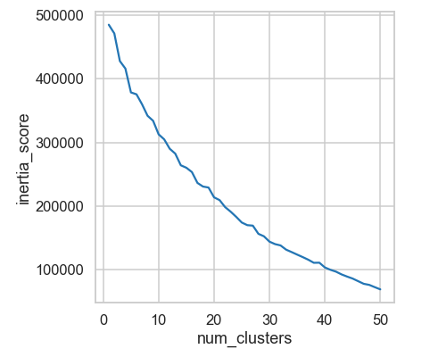
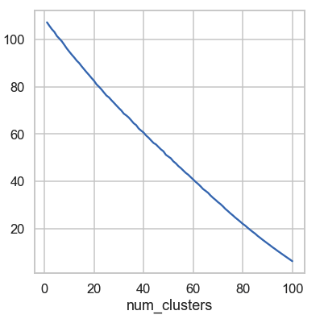
K-MEANS CLUSTERING
num_topics = 16
Count
TF-IDF

Slide 9
Hyperparameter Decisions
Don’t want words unique to single doc
min_df = 2
Don’t want really common words
max_df = 0.5
Reward rare words (likely domain-specific)
TfidfVectorizer > CountVectorizer

Slide 10
NMF Tuning
CountVectorizer
Topic 1 | adult, older, physical, environment, factor, population, health, elderly, live, association
Topic 2 | healthcare, professional, older, study, community, review, experience, approach, relationship, participant
Topic 3 | screen, health, rate, cancer, population, score, higher, factor, knowledge, subject
Topic 4 | cancer, provide, professional, survey, staff, program, set, regard, provider, physical
TfidfVectorizer min_df=2, max_df=0.5, max_features=1000
Topic 1 | older, health, community, adult, literacy, dwelling, cognitive, elderly, frailty, dementia
Topic 2 | surgery, case, procedure, cancer, operation, laparoscopic, surgical, complication, gastric, underwent
Topic 3 | covid, infection, pandemic, emergency, pulmonary, chest, suspect, nurse, sars, cov
Topic 4 | cell, culture, cartilage, tissue, expression, protein, organ, induce, differentiation, apoptosis
Notes:
Emphasize interpretability

Slide 11

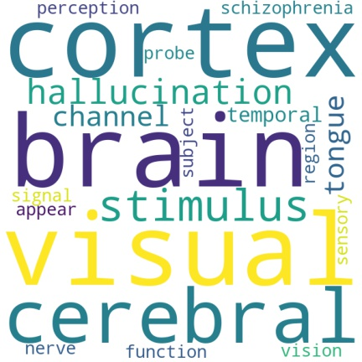
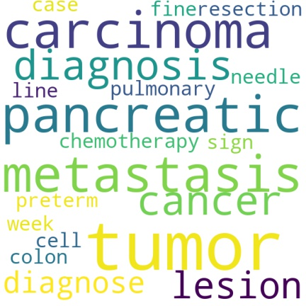
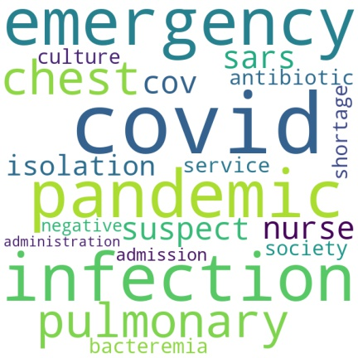
Community Health
Neuroscience
Cancer
COVID-19

Slide 12
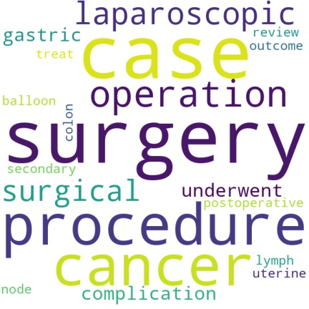
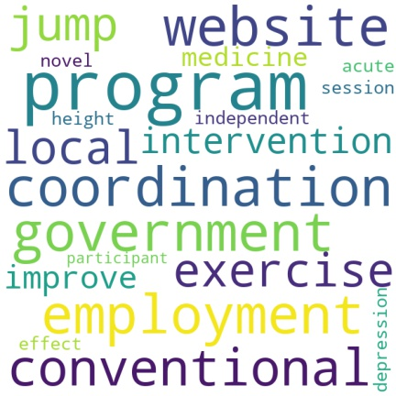
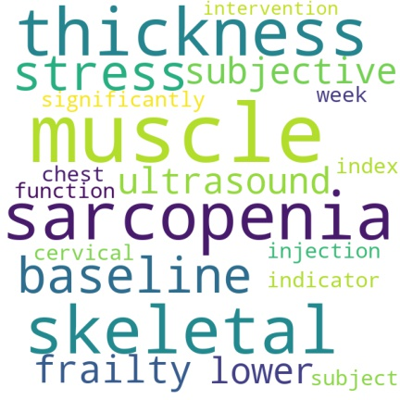
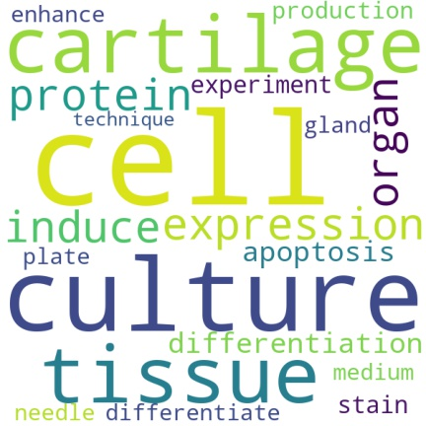
Surgery
SocWelfare
Physiology
StemCell

Slide 13
How Many Topics?
num_topics=16
CommHealth
Surgery
COVID-19
StemCell
Physiology
Cancer
Neuroscience
SocWelfare
Rehabilitation
ObGyn
NursingEd
Endovascular
Stroke
ClinTrial
PubPolicy
Genomics
num_topics=8
Nursing
Surgery
COVID-19
MolBioTherap
FuncHealth
Cancer
Neuroscience
Rehabilitation

Slide 14
How Many Topics?
num_topics=16
CommHealth
Surgery
COVID-19
StemCell
Physiology
Cancer
Neuroscience
SocWelfare
Rehabilitation
ObGyn
NursingEd
Endovascular
Stroke
ClinTrial
PubPolicy
Genomics
num_topics=8
Nursing
Surgery
COVID-19
MolBioTherap
FuncHealth
Cancer
Neuroscience
Rehabilitation
Notes:
The first thing I would point out is that five of the clusters are pretty much the same

Slide 15
How Many Topics?
num_topics=16
CommHealth
Surgery
COVID-19
StemCell
Physiology
Cancer
Neuroscience
SocWelfare
Rehabilitation
ObGyn
NursingEd
Endovascular
Stroke
ClinTrial
PubPolicy
Genomics
num_topics=8
Nursing
Surgery
COVID-19
MolBioTherap
FuncHealth
Cancer
Neuroscience
Rehabilitation
Notes:
‘pregnancy’, ‘teacher’, ‘program’,

Slide 16
How Many Topics?
num_topics=16
CommHealth
Surgery
COVID-19
StemCell
Physiology
Cancer
Neuroscience
SocWelfare
Rehabilitation
ObGyn
NursingEd
Endovascular
Stroke
ClinTrial
PubPolicy
Genomics
num_topics=8
Nursing
Surgery
COVID-19
MolBioTherap
FuncHealth
Cancer
Neuroscience
Rehabilitation

Slide 17
How Many Topics?
num_topics=16
CommHealth
Surgery
COVID-19
StemCell
Physiology
Cancer
Neuroscience
SocWelfare
Rehabilitation
ObGyn
NursingEd
Endovascular
Stroke
ClinTrial
PubPolicy
Genomics
num_topics=8
Nursing
Surgery
COVID-19
MolBioTherap
FuncHealth
Cancer
Neuroscience
Rehabilitation

Slide 18
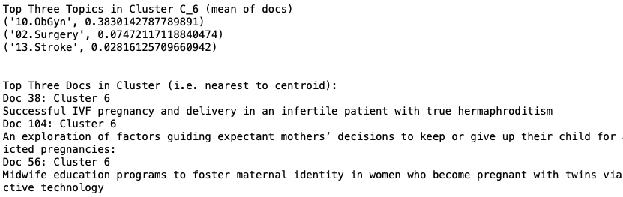
TOPIC-CLUSTER LOADINGS
Notes:
Something interesting I found is that clusters were typically heavily loaded with a single topic, with the next highest topic in distant second.

Slide 19
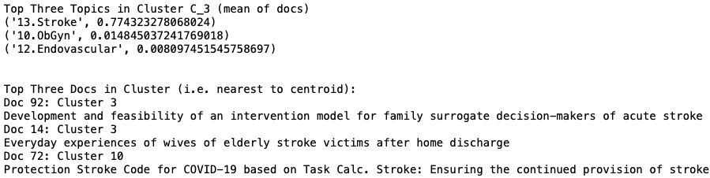
TOPIC-CLUSTER LOADINGS

Slide 20
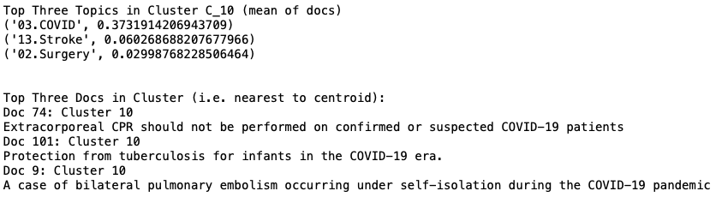
TOPIC-CLUSTER LOADINGS

Slide 21
Next steps:
Same pipeline for Japanese docs
Do same topics emerge?
Do same top words?
Post-MT topic modeling for paper matching
Syntax not important in BOW models
Requires preprocessing of large corpora
Document similarity in neural translation
Topic weights as word features?

Slide 22
THANKS!
Any questions?
Github: streerm
mark.streer@gmail.com

Slide 23
appendix
Bring the attention of your audience over a key concept using icons or illustrations

Slide 24
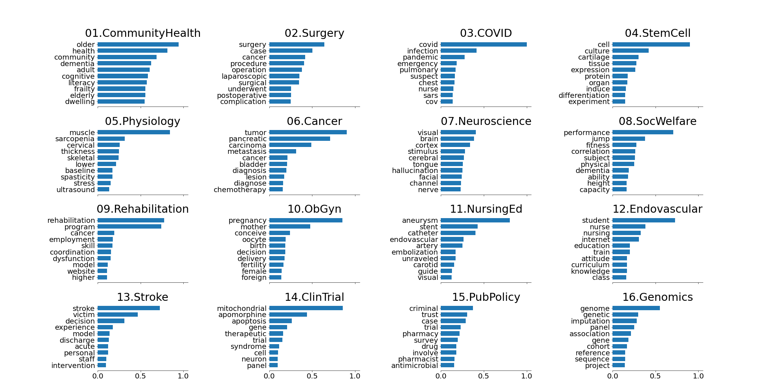
Top Words by Topic (n=16

Slide 25
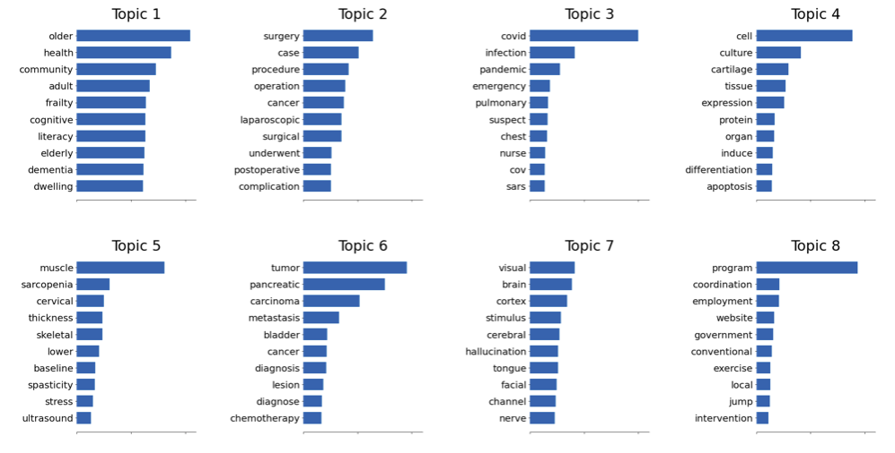
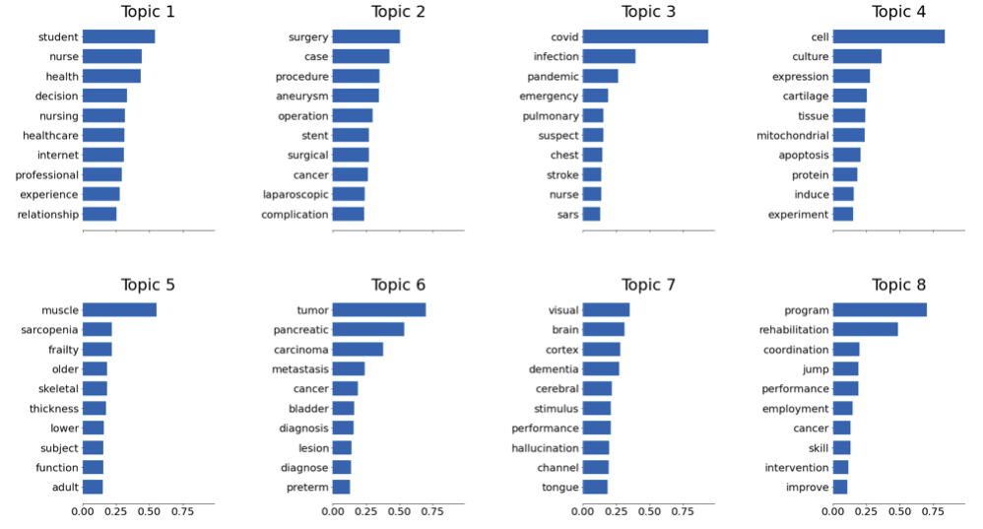
Top Words by Topic (n=16 v. n=8) p.1

Slide 26
Top Words by Topic (n=16 v. n=8) p.2

Slide 27
Motivation
Languages express the same ideas using different words and syntax.
EN: I am hungry. PRON-V(to be)-ADJ
DE: Ich habe Hunger. PRON-V(to have)-N
JP: O-naka ga suita. POL-N-PART-V(past)
お腹が空いた (lit. (my) stomach is empty)

